Slide 1

Graduate Medical School Project
Boston University
Supervised Professor: Benjamin P Harris
Team: Zhen Fu, Usman Khan
05/09/2022

Slide 2
Agenda
Project Overview & Background​
Application Prediction
Control Chart & Warning Signs
Data Visualization

Slide 3
Project Overview

Slide 4
Project Overview
Background
Medical school takes efforts to keep their program healthy, they need to understand whether their marketing really has an impact on the number of student enroll each year. Thus, have a better sense of application trend in early is important.
Proposal
Understanding enrollment process and predicting the application trending of ongoing cycle. Target to certain programs which have low performance, try to Identify its potential trends and provide early warning

Slide 5
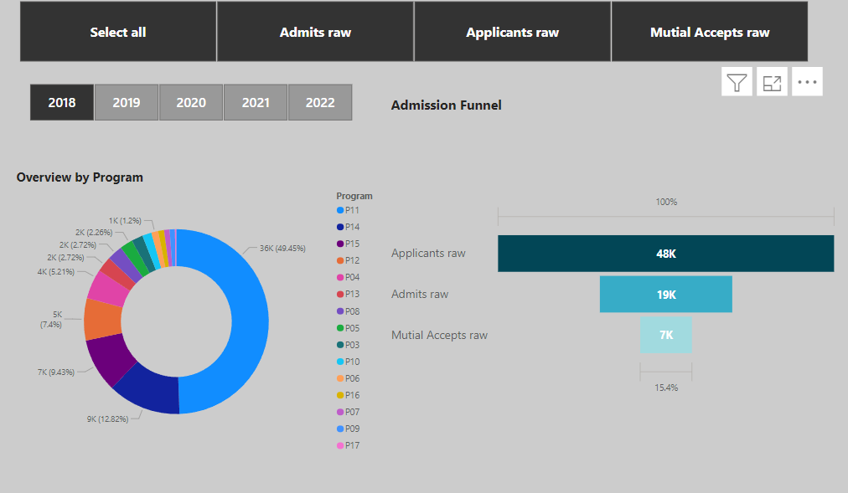

Slide 6
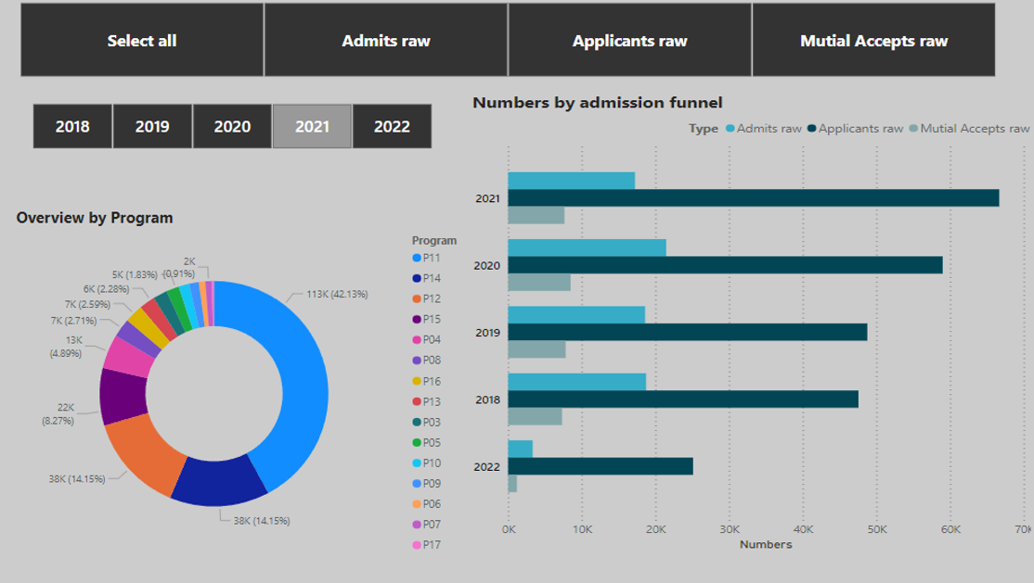

Slide 7
Application Prediction

Slide 8
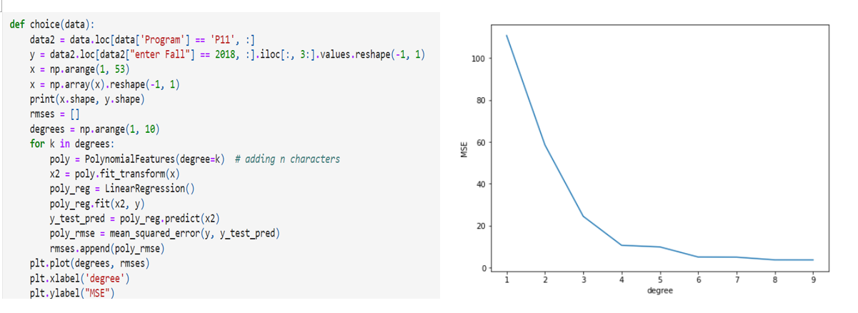
Prediction
Choose the degree of polynomial function

Slide 9
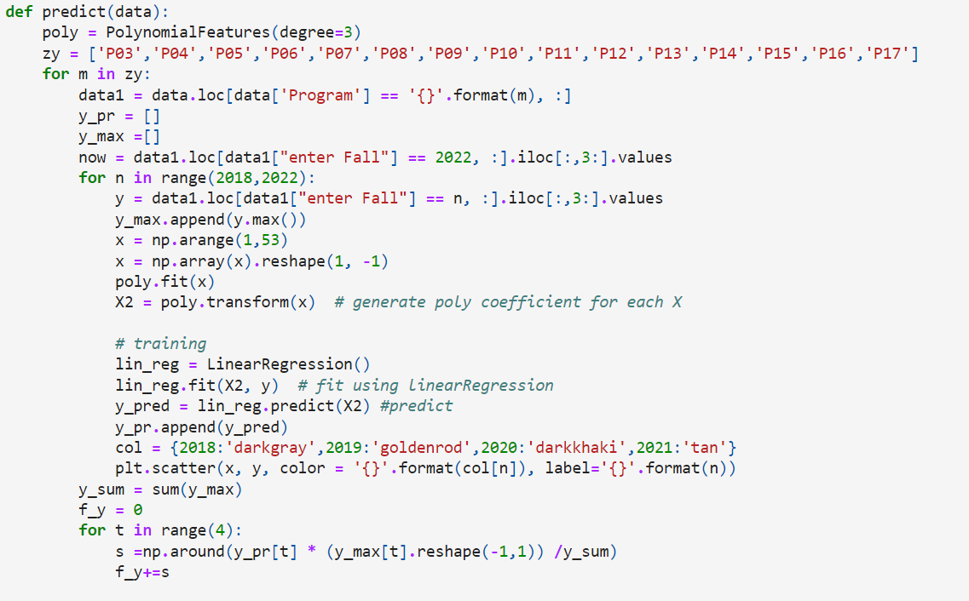
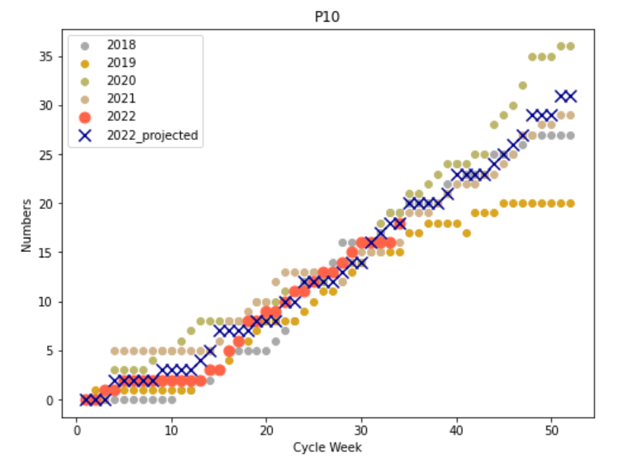
Prediction
Polynomial Prediction

Slide 10
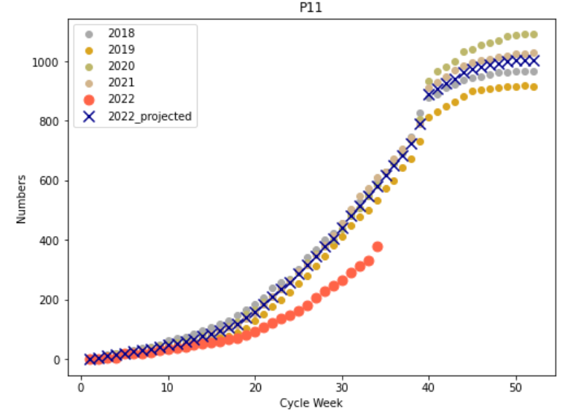
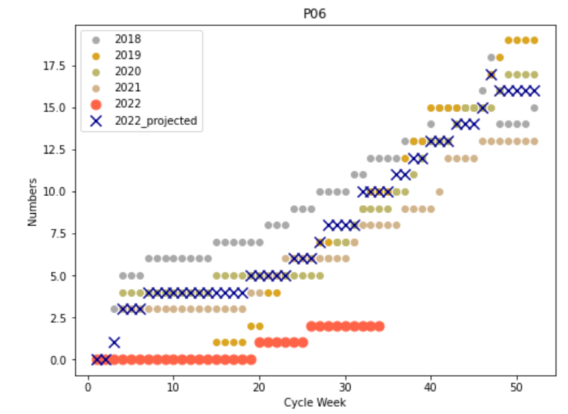
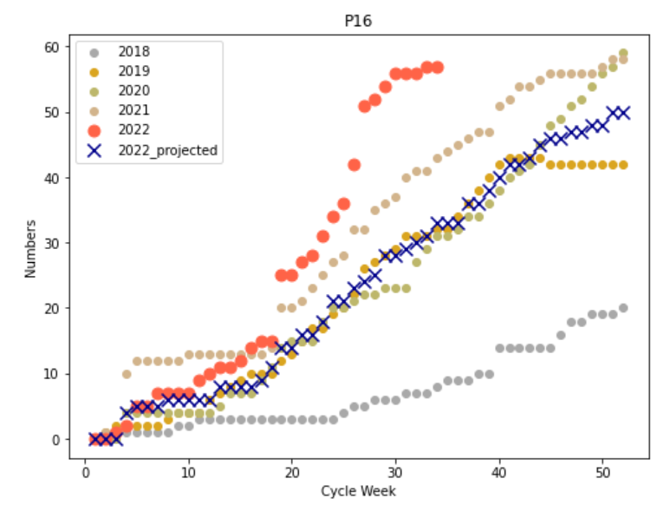
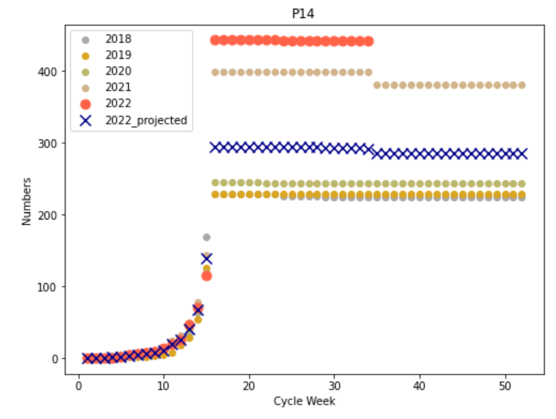
Key Takeaways​
Virtual communication with results:
Programs like P06, P11 deviated from the prediction
Programs like P14, P16 above expection

Slide 11
Control Analysis & Dashboard

Slide 12
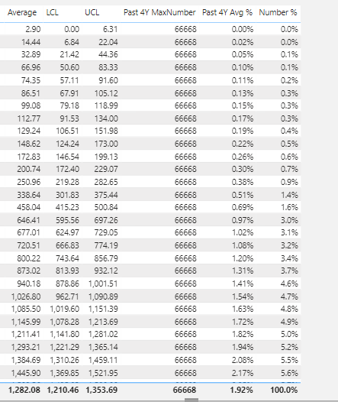
Control Chart
Calculated the average percentage for each week
Set up the expectation applicant number
Calculated the expectation number for each week-----baseline
Compared ongoing records with baseline and also with 95% confident interval

Slide 13
Triggers
Four characteristics indicate a warning:
1) Five continuous weeks out of the 95% CI
2) Seven continuous weeks below the average,
3) Three continuous weeks out of lower limit,
4) Seven points trending down
All the situation count after week 10.

Slide 14
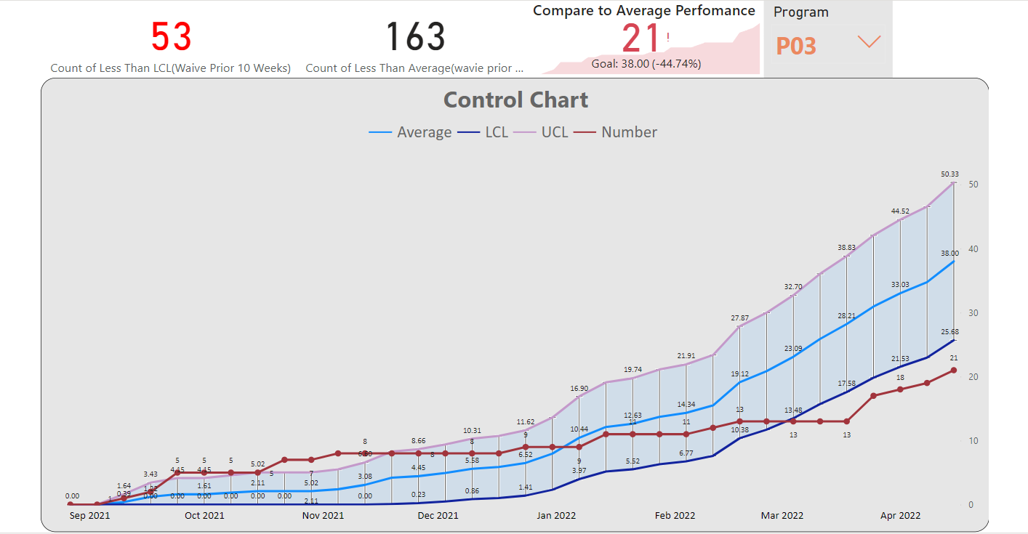
Dashboard
Dashboard in Power BI

Slide 15
Topics for Further Analysis by future teams
Direct upload from Boston University systems to automate Dashboard
Utilize Web analytics combined with application to pre forecast numbers
Do cluster analysis of applicants to further analyze who says yes and who say no.

Slide 16

Thank You

